Slide 1
MGCR 222 - Introduction to Organizational Behaviour
Chapter 11-
Communicating With Purpose
Maya Sharma

Slide 2
Learning Objectives
Explain the Four-Step communication process
Identify common barriers to effective communication.
Approaches to filtering Information
Choosing Communication Media and Channels
Overcoming Barriers to Communication
Consider conventional and sustainable approach to communication

Slide 3
Communication: An Essential Skill
We are constantly communicating to the outside world
Strong communication skills are fundamental to professional success in organizations.
Technological and social developments underline the importance of communication skills ex: mobile devices, telecommuting, social media, etc.
Notes:
3

Slide 4
Communication Basics
What Is Communication?
The Importance of Communication in Organizations
Communication takes place throughout organizations and at all different levels.
Lateral, downward and upward communication
The communication process has four basic steps

Slide 5
The Four-Step Communication Process
The Four Basic Steps :
Identify the message
Encode & Transmit
Receive & Decode,
Confirm
Movement across steps can be hampered by the context & the media

Slide 6
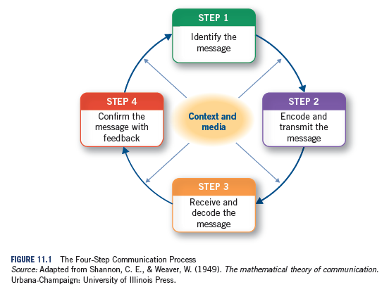

Slide 7
Step 1- Identify Your Message
What is a Message?
Filtering:
Can be Positive And Negative
Conventional VS Sustainable Approach to messages

Slide 8
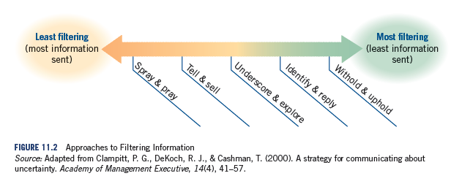
Approaches to Filtering Information
Information level
Information

Slide 9
Step 2: Encode and Transmit
Encoding
Media differ in their capacity to convey information and resolve ambiguity
multiple cues
rapid feedback
emotional connection
Factors to consider when selecting a medium: Communication apprehension, medium richness, level of routine
Notes:
9

Slide 10
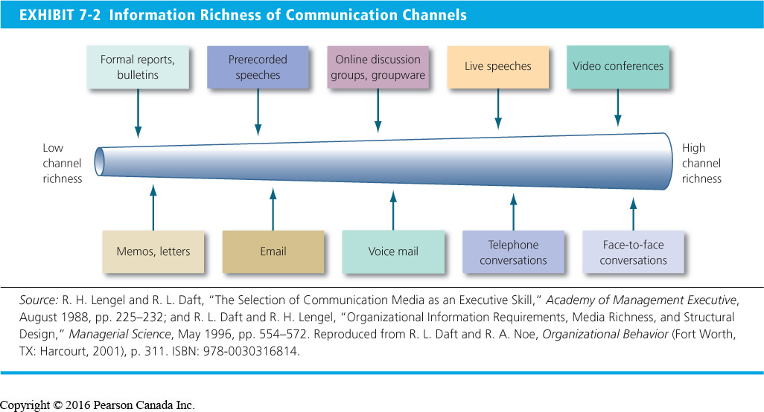
Choosing the Media
Routine Non Routine
LOW
HIGH
Notes:
10

Slide 11
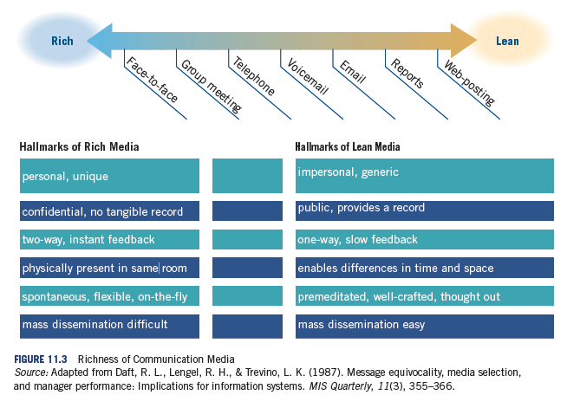

Slide 12
Choose Communication Media and Channels
Channel
Grapevine
Deliberate Dialogue
Conventional and Sustainable OB Approaches

Slide 13
Examples of Barriers to Communication (Noise)
Communication Barriers
Cultural Differences
Filtering
Language and Semantics
Selective Perception
Information Overload
Barriers to communication (i.e. Noise)
Personality Differences
Emotions
Selective use of words
Relationships
Nonverbal

Slide 14
Semantic Problems- Words that have different meanings in the North & South USA
Sugar:
North: sweetener normally used for baking.
South: a kiss
Fixing:
North: Repairs
South: getting prepared to do something
Dope
North: Drugs or something is “cool”
South: toppings that you put on your ice cream sundae
“Bless your heart”
North: a way of showing sincerity and appreciation.
South: a way of telling someone they are an idiot.

Slide 15
Decoding Nonverbal Cues
He’s angry! I’ll
stay out of his way!
He’s
unapproachable!
Action: Boss fails to acknowledge
employee’s greeting
Action: Boss breathes heavily and waves arms
I wonder what
he’s hiding?
My opinion
doesn’t count
Action: No eye contact while communicating
Action: Manager sighs deeply
Notes:
21

Slide 16
Types of Nonverbal Communication
Facial and Eye Behaviour: Movements that add cues for the receiver
Paralanguage: Variations in speech, such as pitch, loudness, tempo, tone, duration, laughing, and crying
Proxemics: An individual’s perception and use of space
Kinesics: Study of body movement and posture

Slide 17
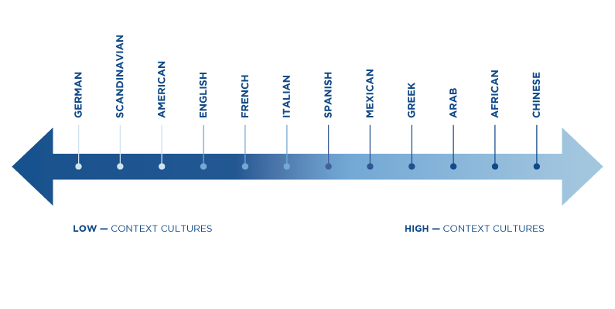
High- vs. Low-Context Cultures: Overcoming Cross Cultural Communication Barriers
Neese, Brian. ” Intercultural Communication: High- and Low-Context Cultures”. Southeasern Univerity http://online.seu.edu/high-and-low-context-cultures/
Notes:
17

Slide 18
Step 3- Receive and Decode The Message
Listening Skills (Active Vs. Poor)
Collective Decoding
Challenges of Decoding

Slide 19
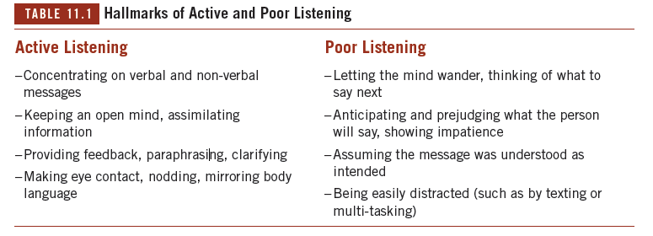

Slide 20
Step 4 - Confirm The Message With Feedback
What Is Feedback?
What Is Constructive Criticism?
Feedforward Communication – can be positive or negative

Slide 21
Next Steps
After this Wednesday’s class, our next class will be March 12th.
Chapter 12: Understanding Organizational Culture and Structure

